Slide 1

ECE 5397/6397:
Introduction to Robotics
Lecture 12:
The manipulator Jacobian
Reference: Chapter 4.4-4.6, RD&C
Instructor: Aaron Becker

Slide 2
Welcome!
1st grade class invited us to show our robot arms on Tuesday, March 1st. ECE publications office would like to send a reporter and a photographer. I need 5 volunteers to make this happen
4pm tomorrow: tips & tricks for Swarmathon
HW 4 on the Jacobian is due Mar 3
Notes:
Teleoperators from WWII to handle radioactive materials
CNC developed because of high precision required to machine certain items
----- Meeting Notes (2/25/16 12:09) -----
duplo blocks
2pm

Slide 3
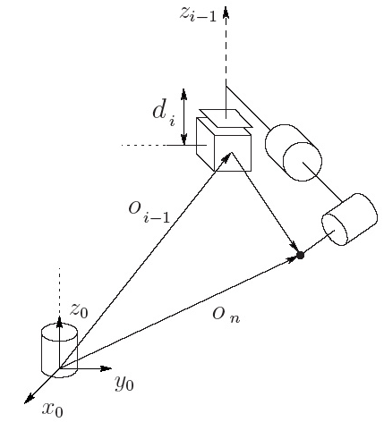
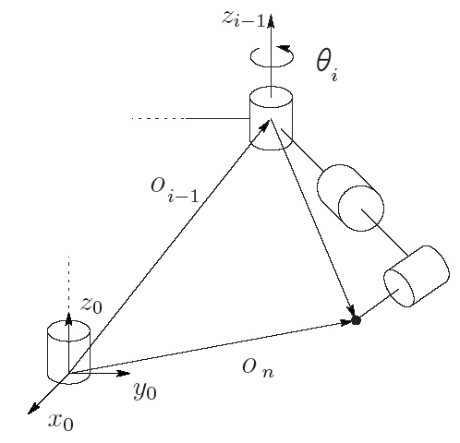
Goal: define Jacobian
Notes:
Procedure also works for defining the velocity of any point on the manipulator. Cool!

Slide 4
Goal: prismatic Jacobian
Notes:
Procedure also works for defining the velocity of any point on the manipulator. Cool!

Slide 5
Goal: revolute Jacobian
Notes:
Procedure also works for defining the velocity of any point on the manipulator. Cool!

Slide 6
To make Jacobian
You need the third and fourth columns of T_{i}⁰

Slide 7
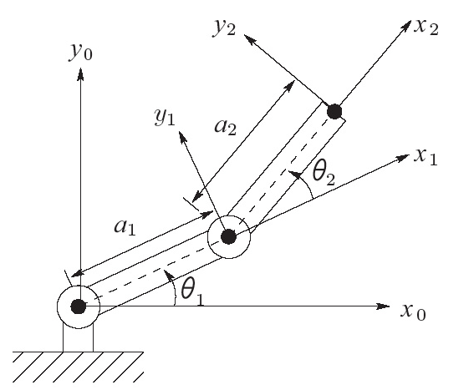
Two-link planar manipulator

Slide 8
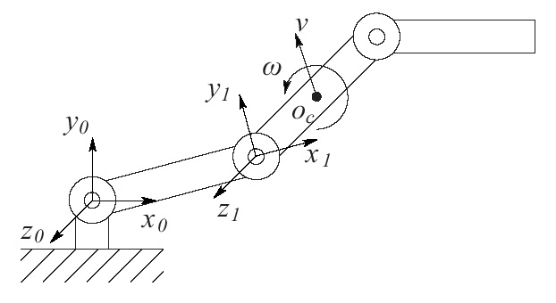
Velocity of link 2 of 3-link robot

Slide 9
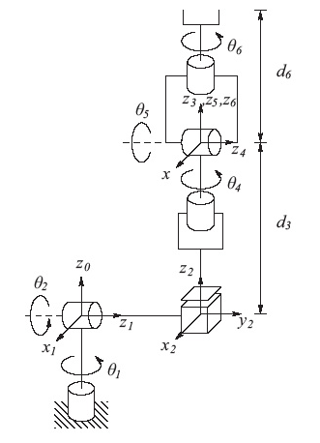
Stanford Manipulator
Notes:
----- Meeting Notes (2/25/16 13:03) -----
send the jacobian to class

Slide 10
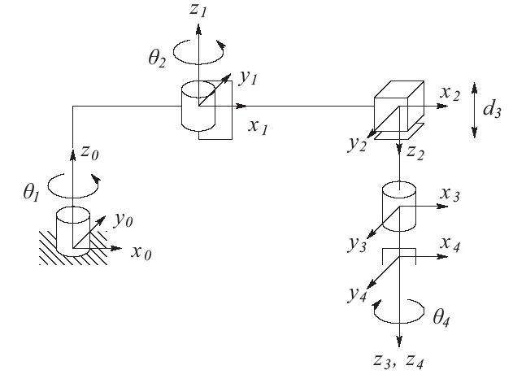
SCARA manipulator

Slide 11
SCARA manipulator

Slide 12
SCARA manipulator
Notes:
Add errata 4.73 page 137 d_3 should be –d_3 for z component

Slide 13
For the Next Class
Study Ch 8 A Gentle Introduction to ROS for Lecture 13

Slide 14
In class worksheet

